Slide 1
August 2018 Update
“Know your control”

Slide 2
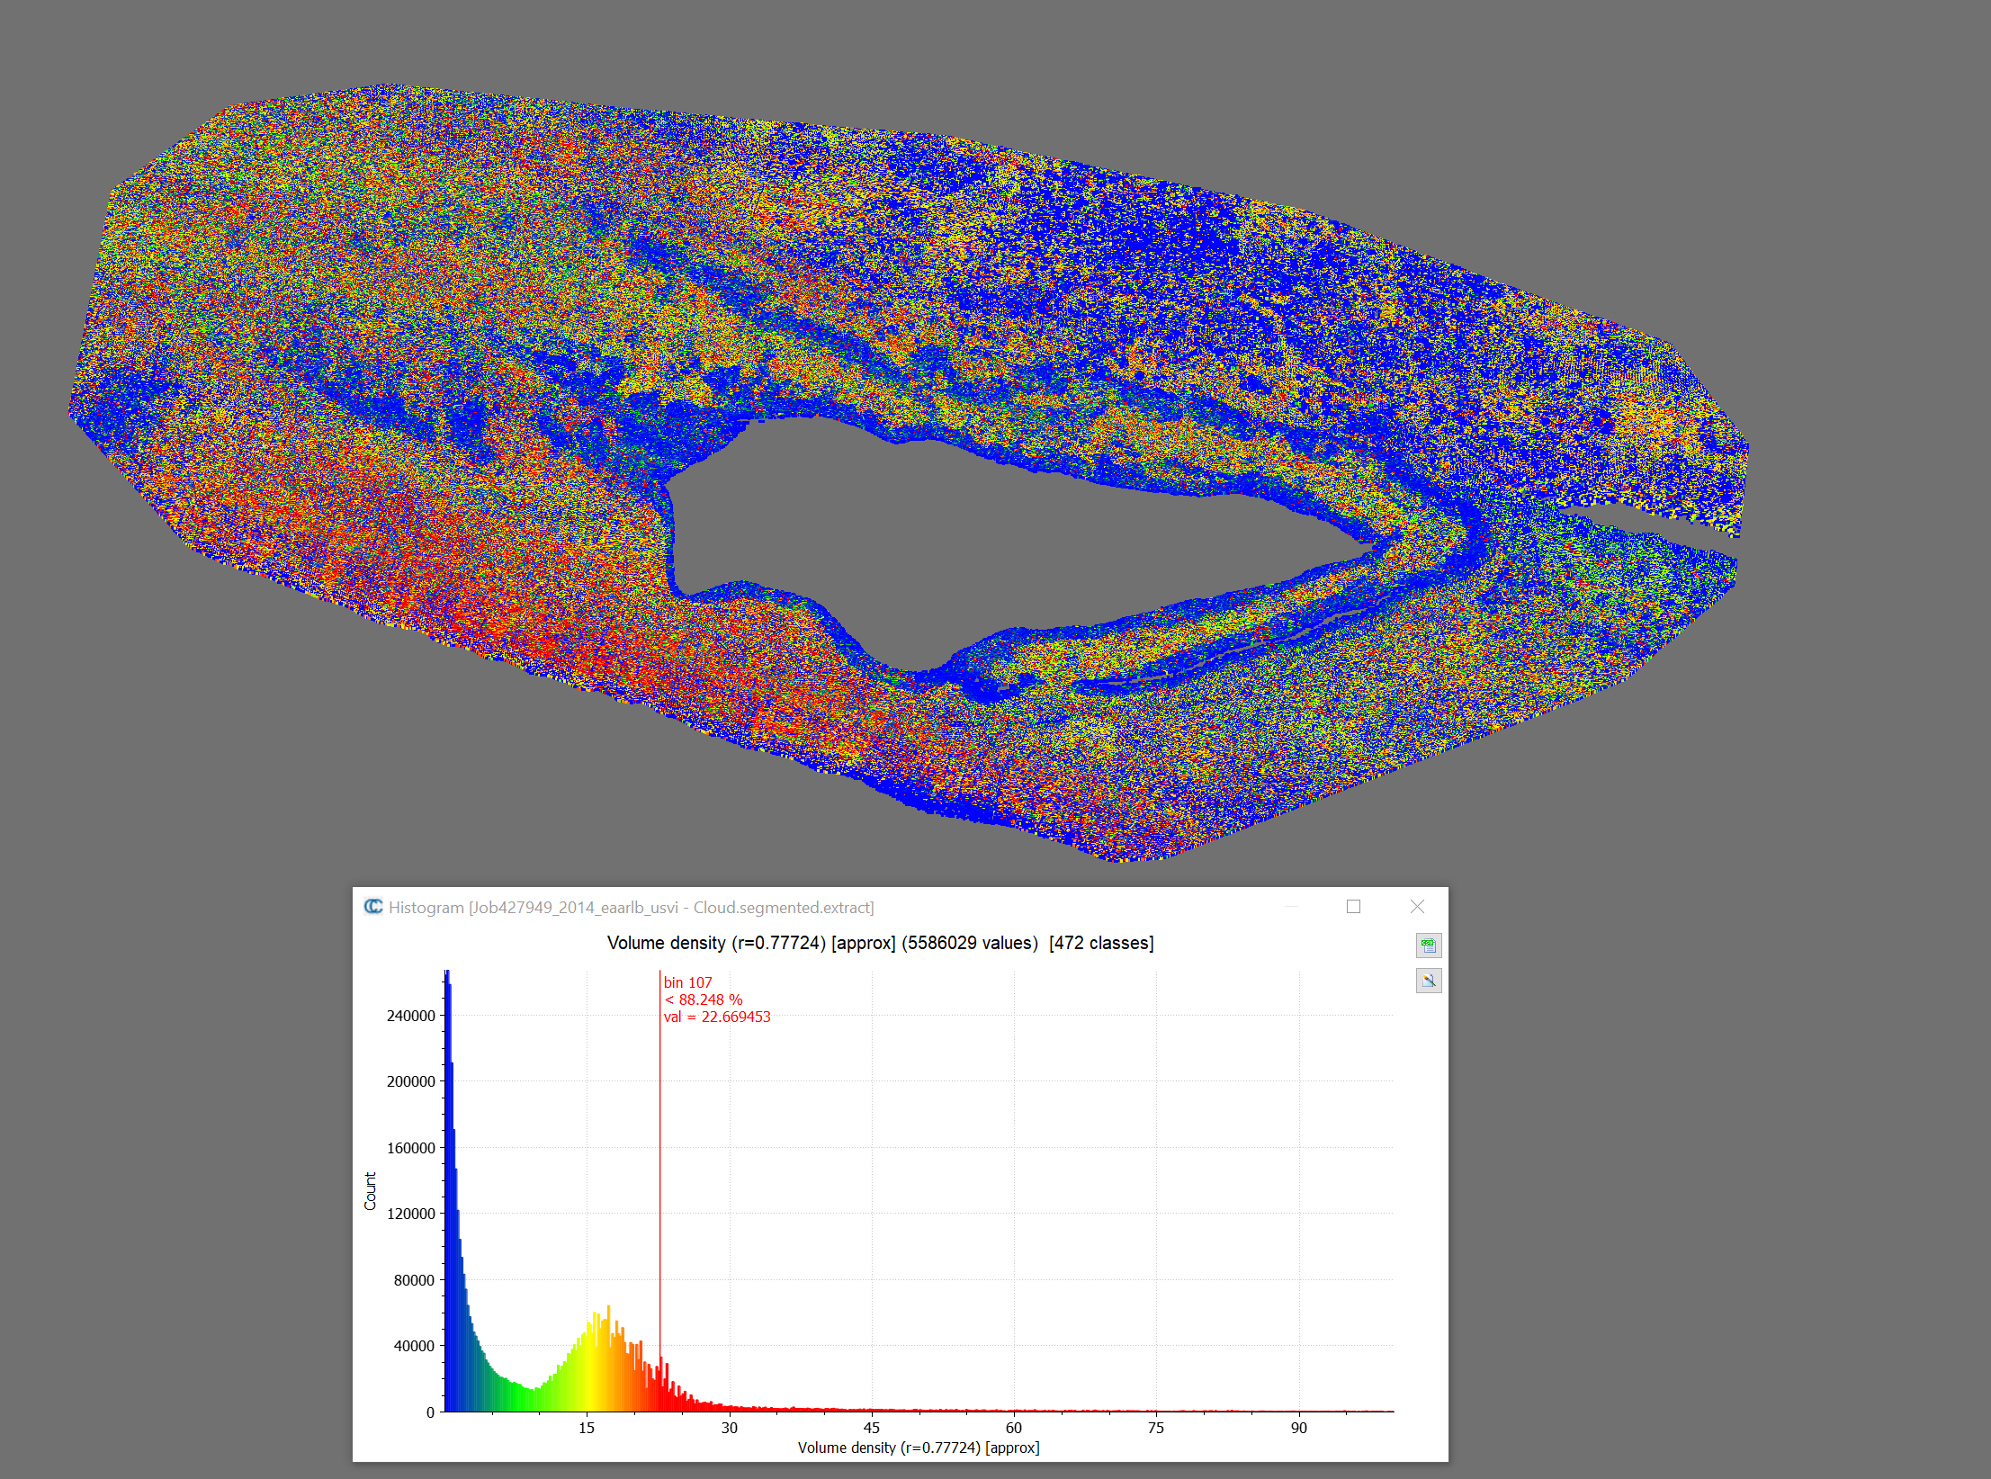
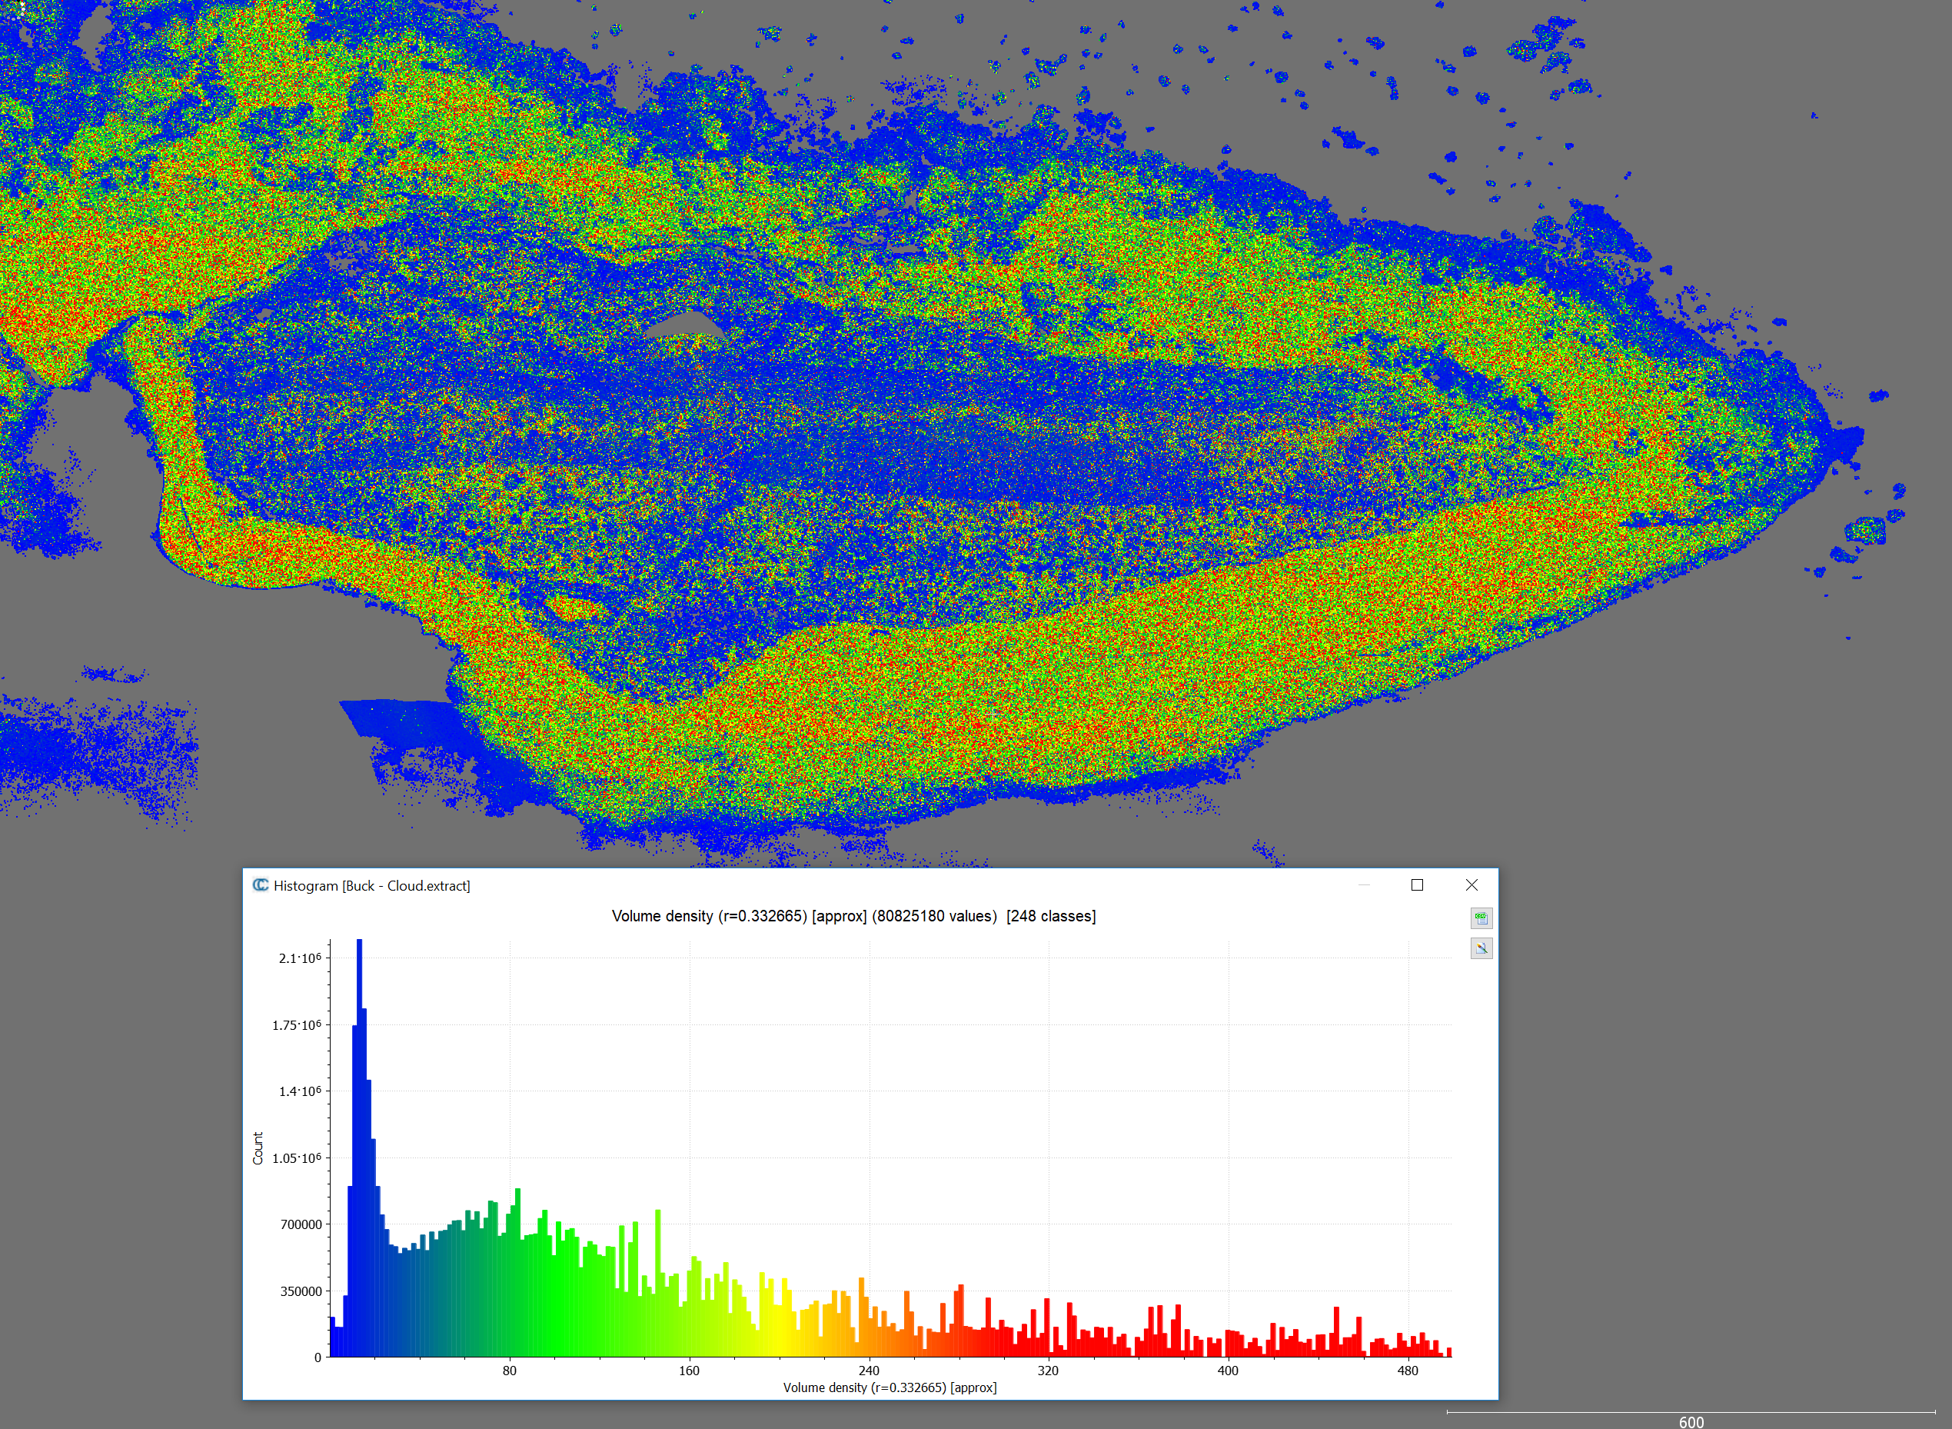
Old Lidar Data
2011 LADS
3m x 3m gridded
Only Buck Island
2014 EAARL B
~25pts/m³
Only Buck Island
2014 NGS RIEGL
~150pts/m³
Data available at all Sites
2018 JABLTCX
-TBD
EAARL B = ~25pts/m³
RIEGL = ~150pts/m³

Slide 3
Validation Data for Each Site
Control Data | NW Buck Island | All Buck Island | Whale Point | Isaac Bay | Jacks Bay | Rod Bay
2011 LADS | x | x
2014 EAARLB | x | x
2014 RIEGL | x | x | x | x | x | x
2018 Total Station | x |  |  | x | x | x
2018 Kayak Sonar | x |  | x |  |  | X
2018 JABLTCX | x | x

Slide 4
Kayak to Total Station Comparison
Z_{Kayak} – Z_{Total Station} when points are <= 1 meter apart
Positive indicates Kayak > Sonar
For multiple points, the median was used
* NOTE: The Rod Bay Kayak data was adjusted by 0.765m
Due to a processing error where the rod height was incorrect
No indication of a bias in any of the datasets

Slide 5
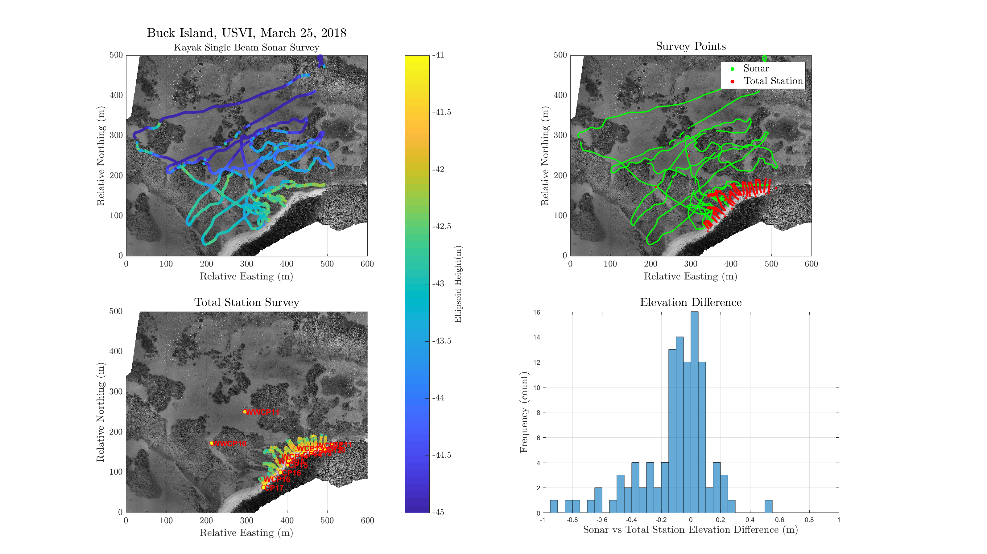

Slide 6
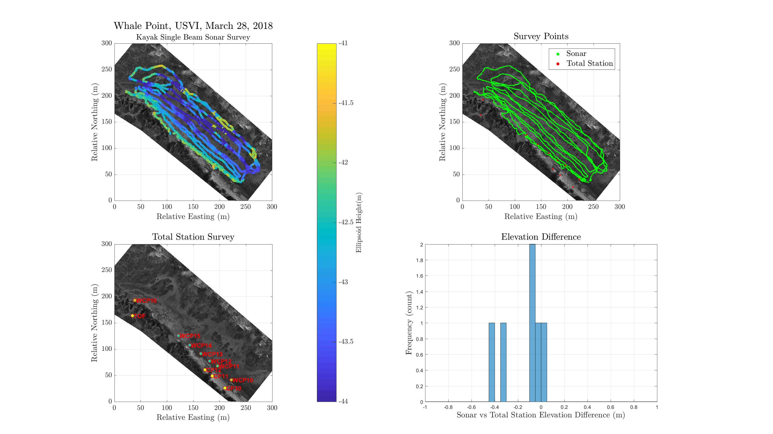

Slide 7
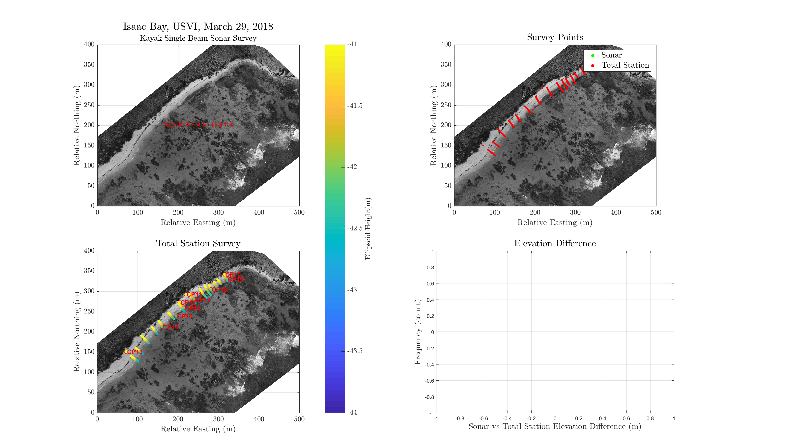

Slide 8
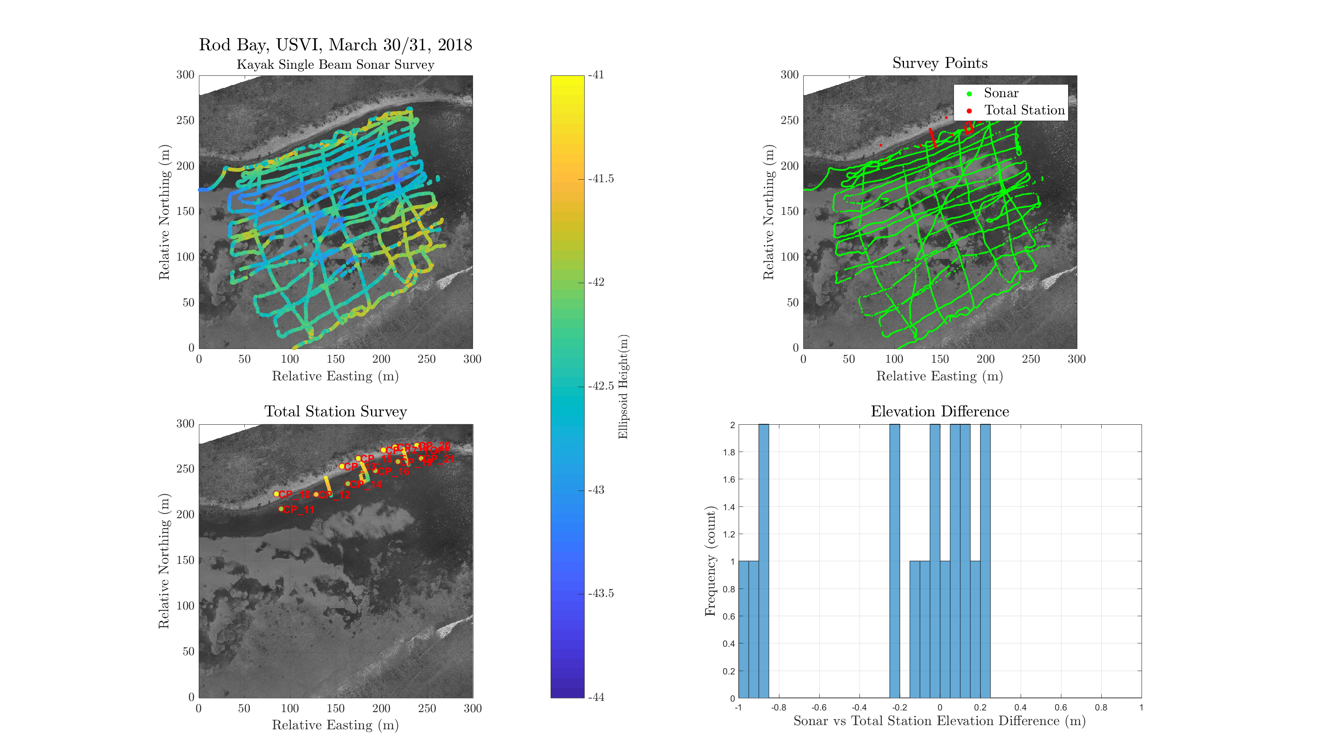

Slide 9
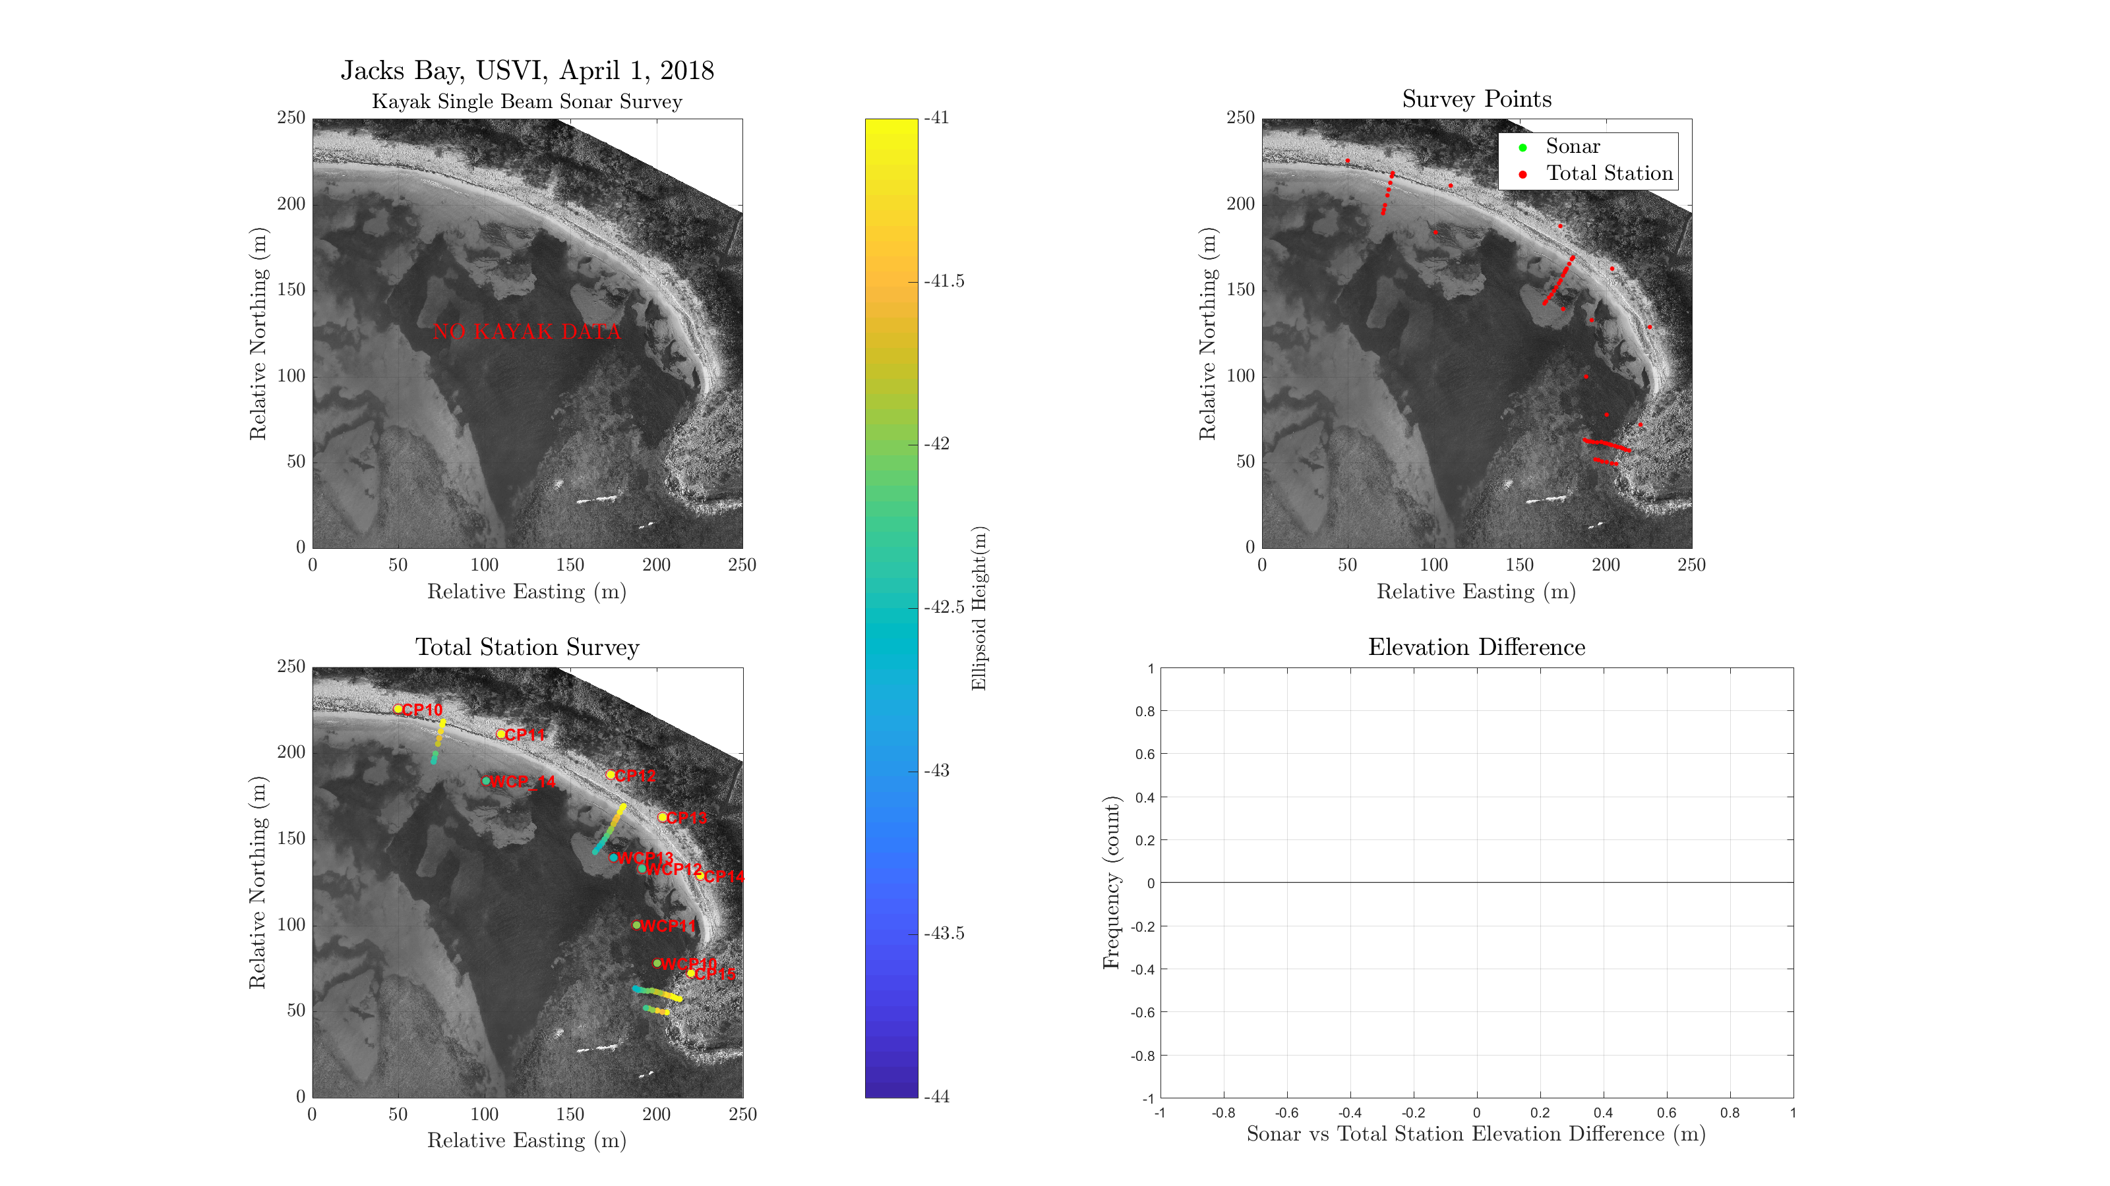

Slide 10
Control Data (Kayak&TS) to Lidar Data
Data for control and lidar were each gridded to 1m x 1m bins
Mean of all points within a grid cell using custom roundgridfun.m script
ΔZ computed for each grid cell
Z_{Lidar} – Z_{Kayak & TS}
Positive indicates lidar is higher

Slide 11
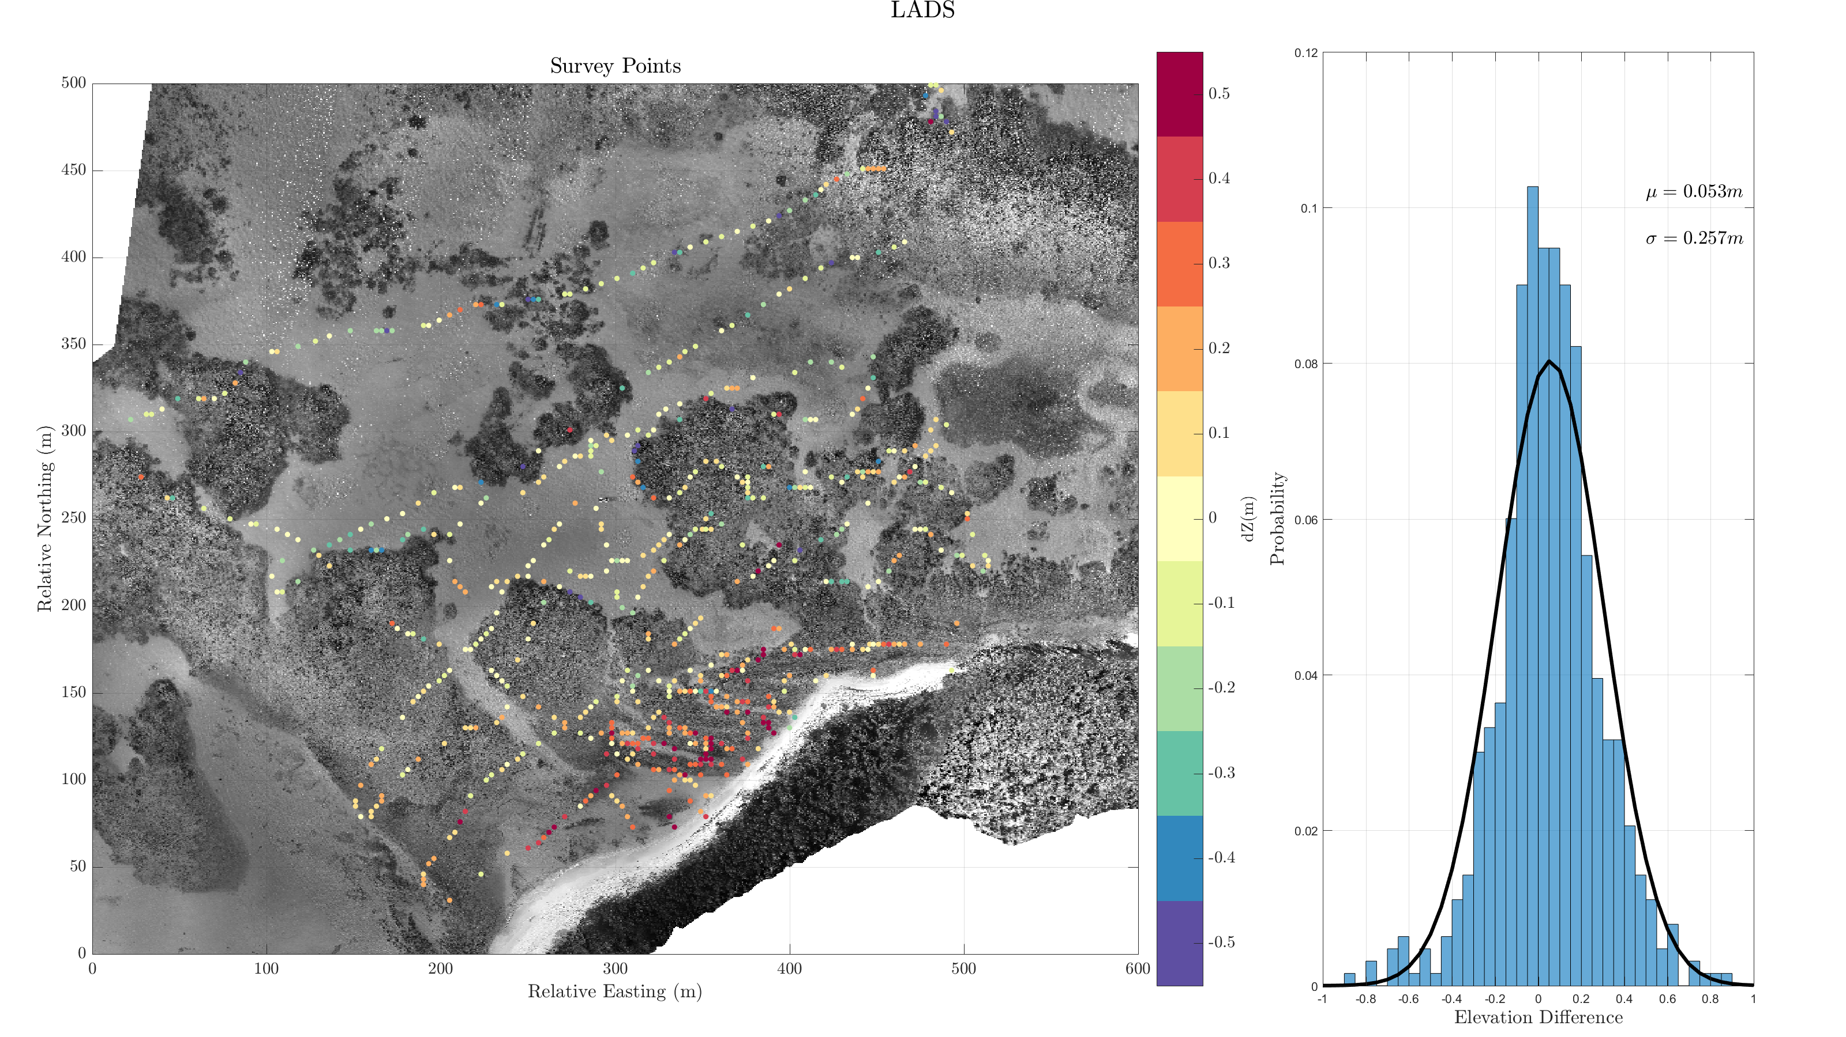

Slide 12
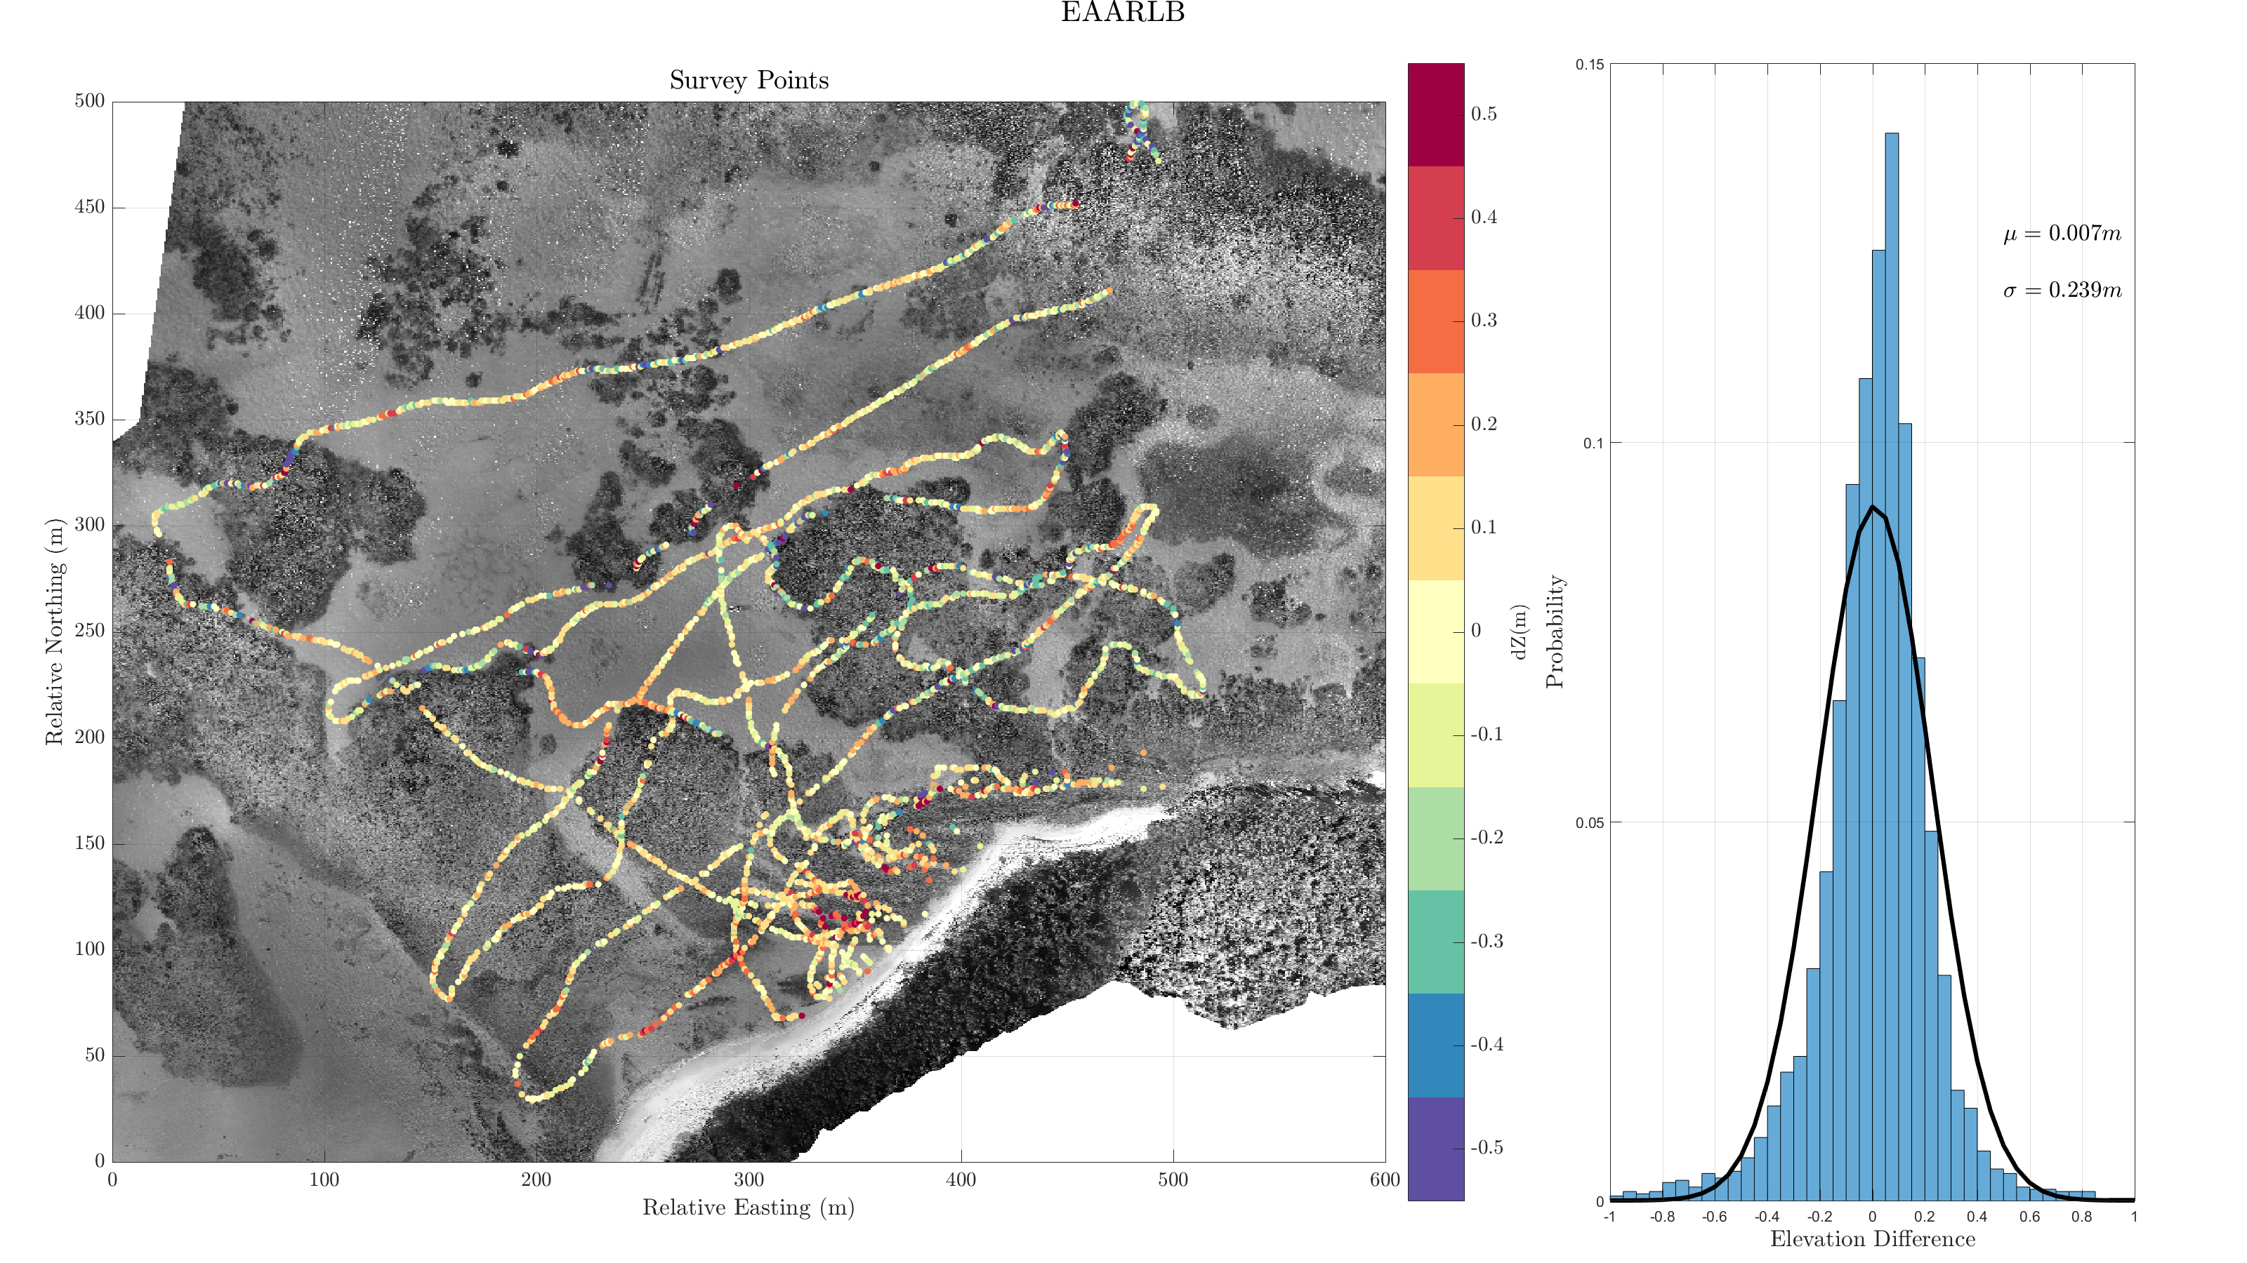

Slide 13
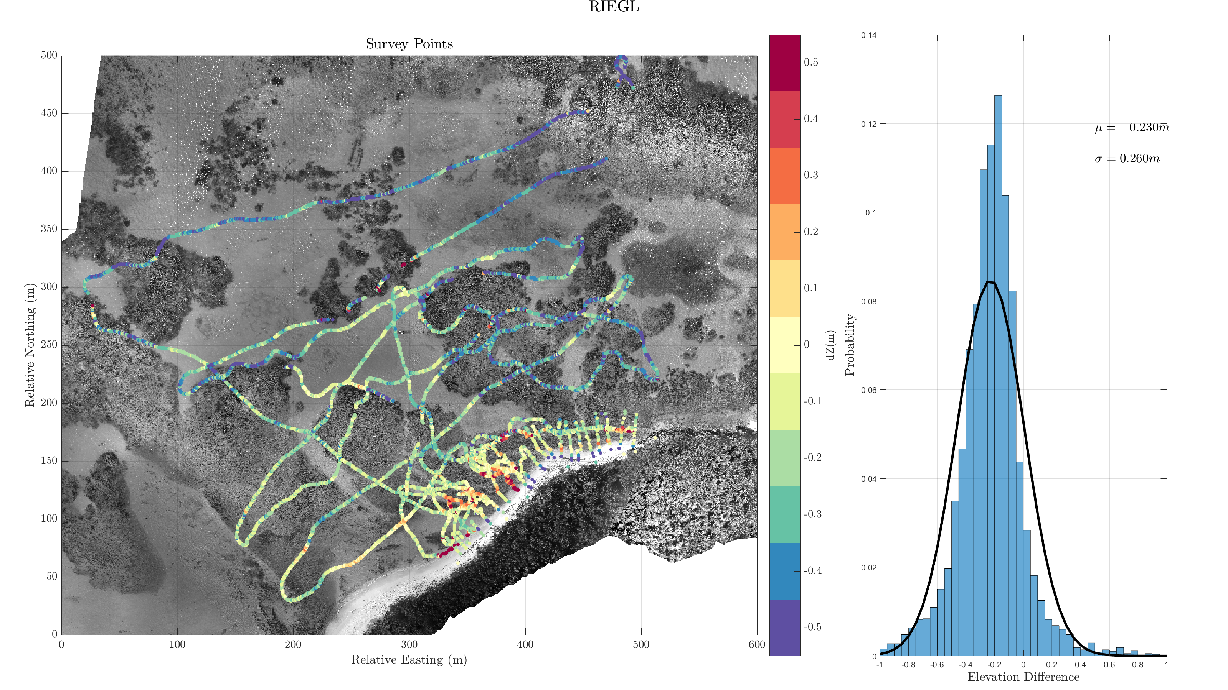

Slide 14
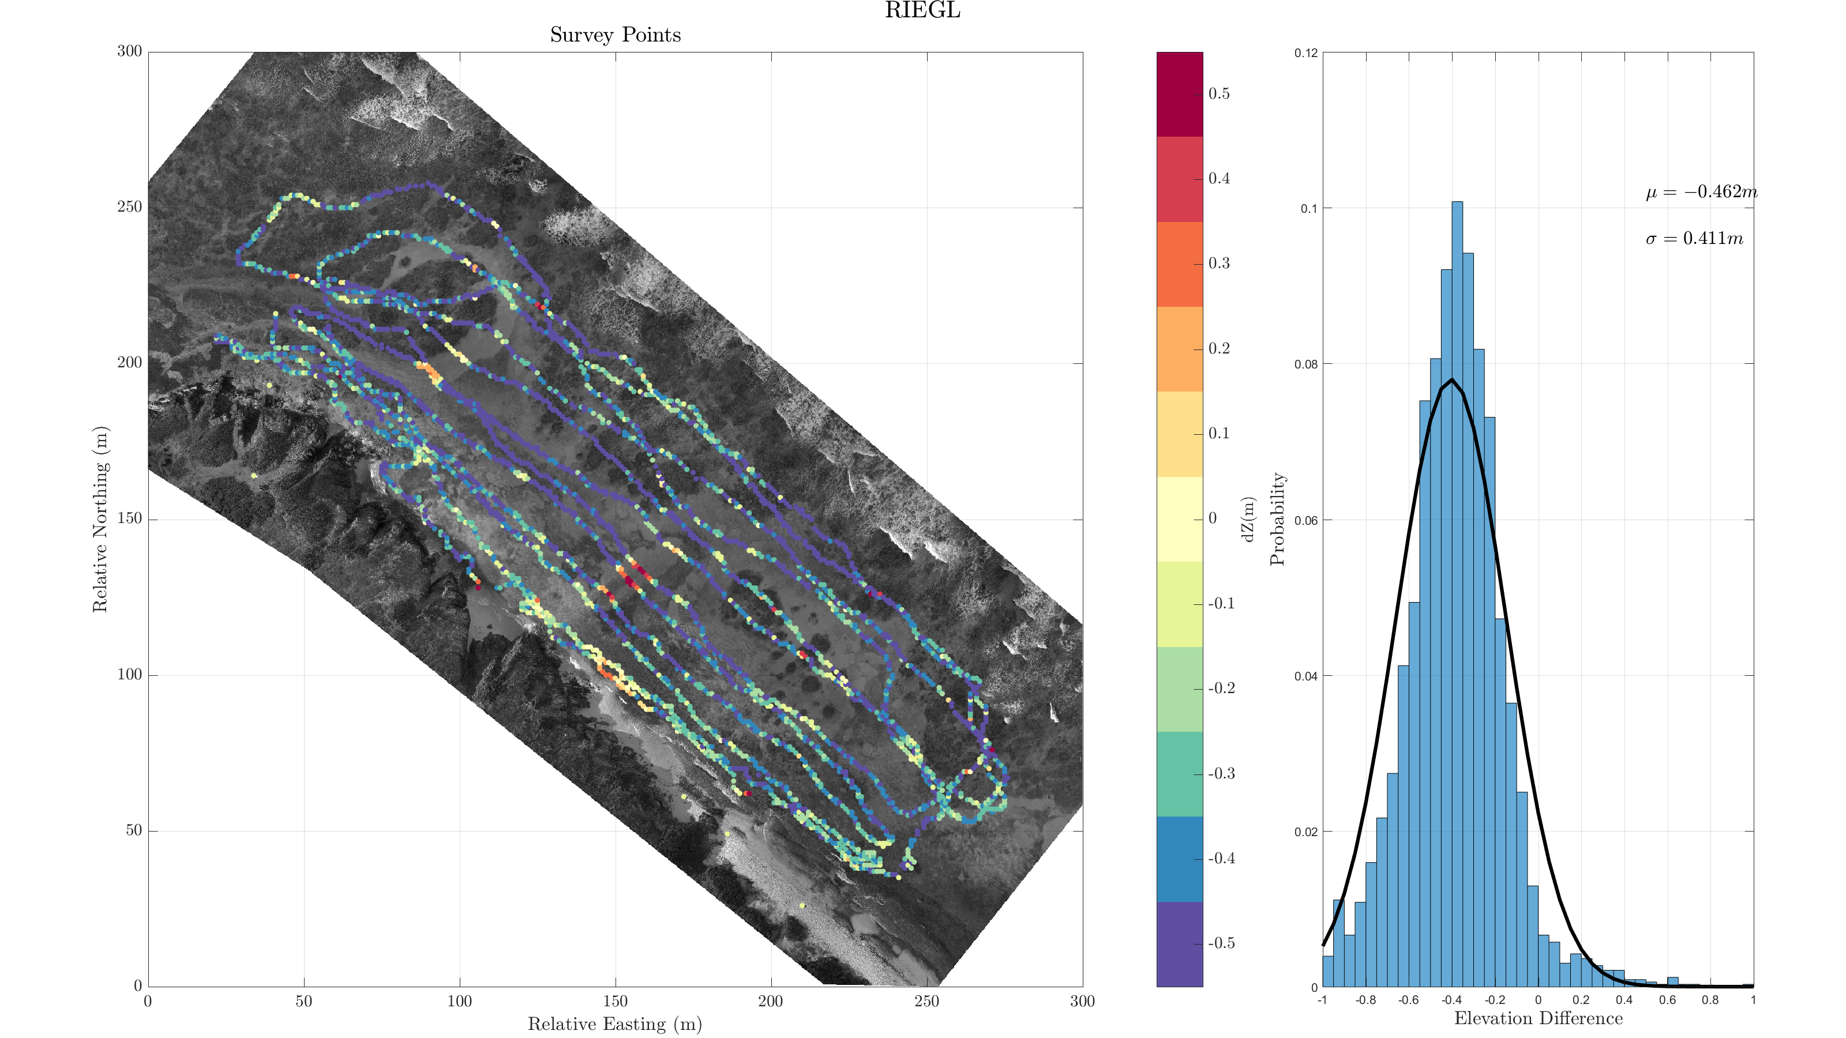

Slide 15
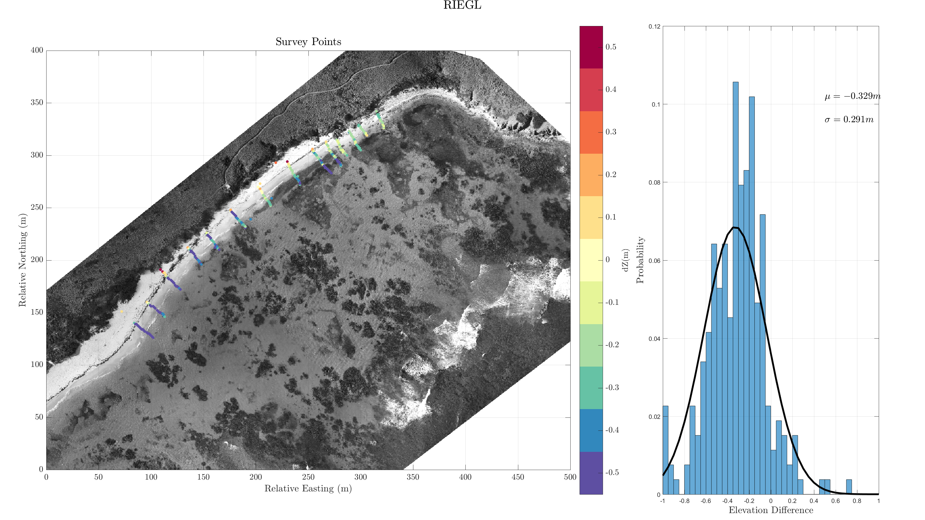

Slide 16
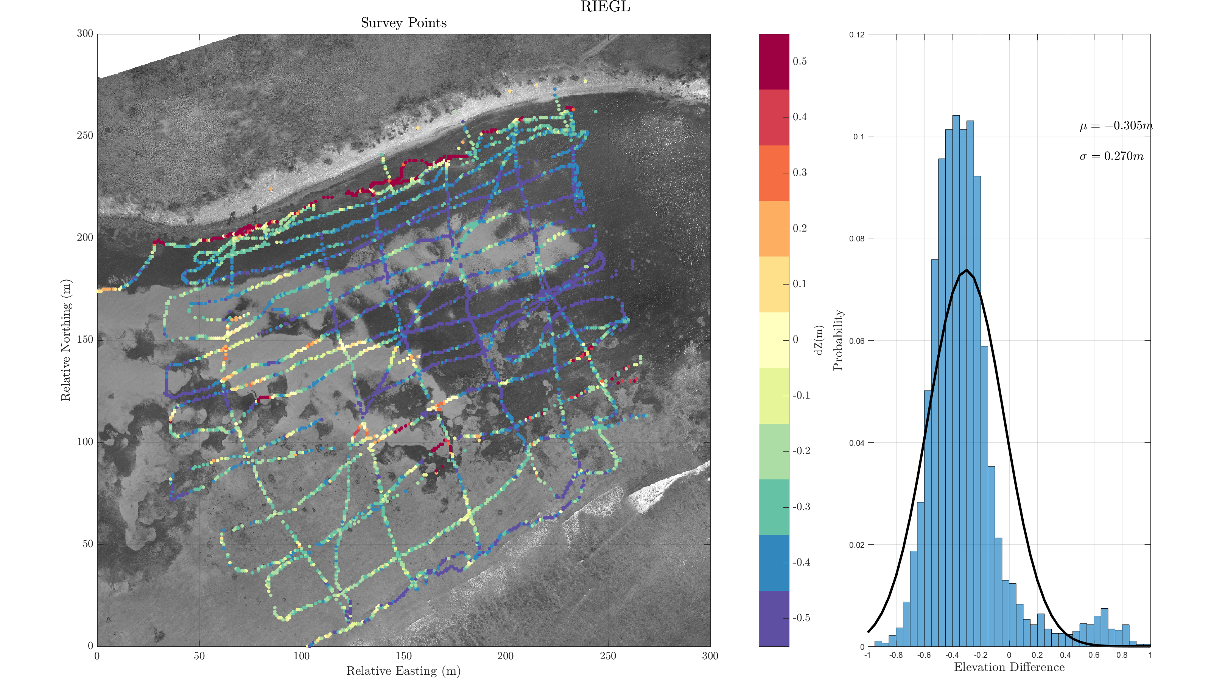

Slide 17
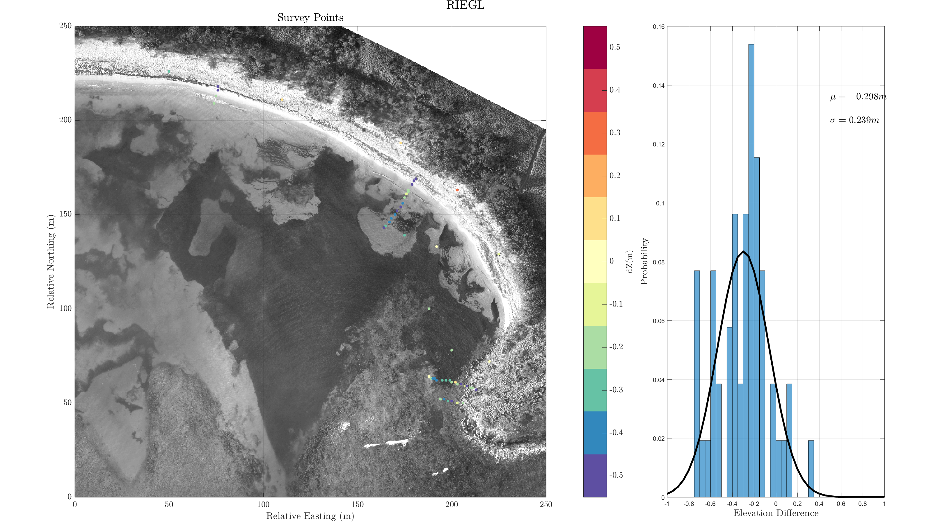

Slide 18

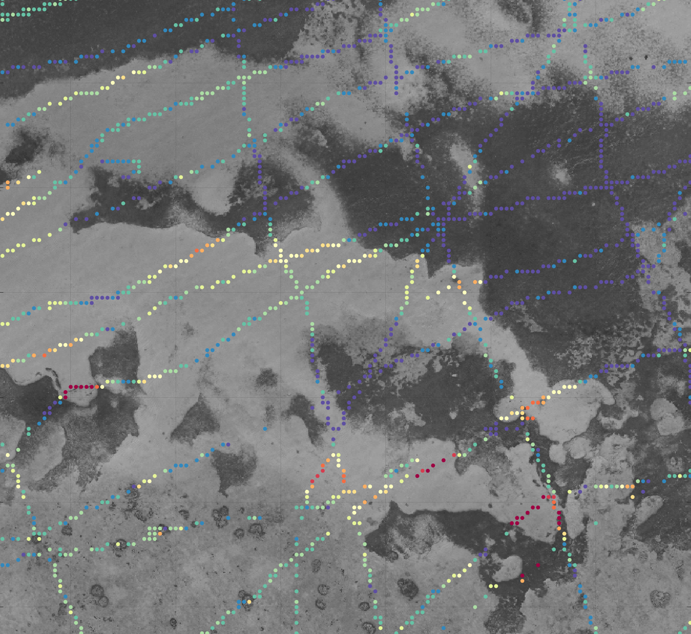
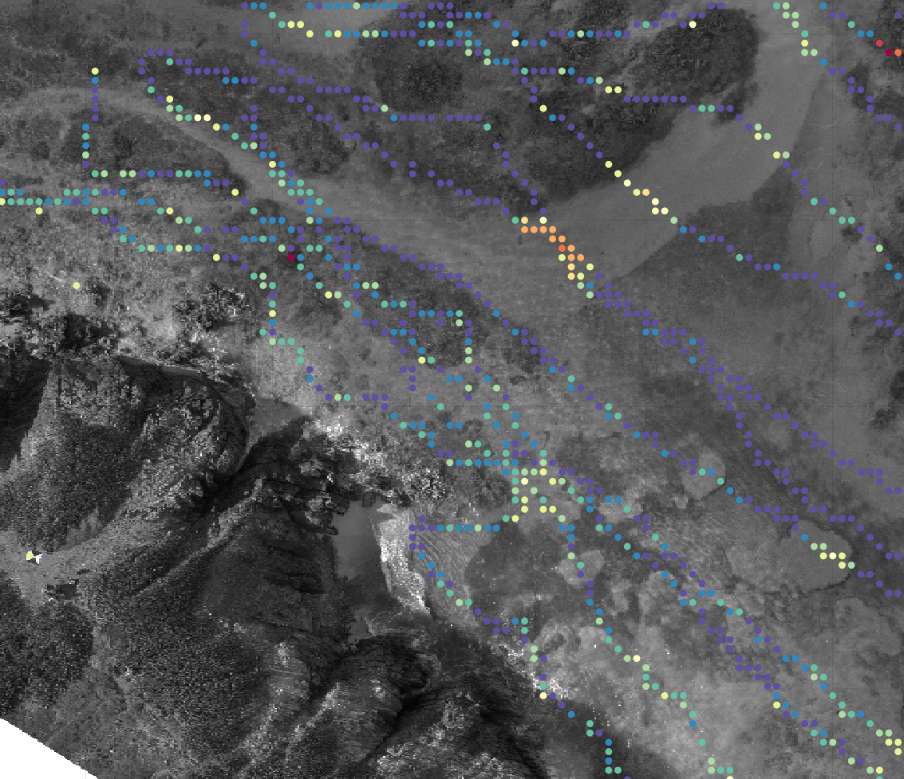
Results
Riegl Consistently ~30cm too low
Real changes since 2014
Correlation between error and bottom type
Rod Bay
Whale Point

Slide 19
“Know your Control” Conclusions
2014 Riegl and EAARLB Data are arguable useable for hard surfaces
I think it is valid to include cautiously, and with caveats, in a paper
Riegl data needs a vertical shift of ~30cm
Preferably, JABLTCX will fly all the sites and we won’t need to
Need to decide how to handle uncertainty shown in kayak-total station
Due to sharp gradients at the edge of reefs?
Due to seagrass?
Uncertainty inherent to the sonar?

Slide 20
My Next Steps (In Parallel)
Analysis
Processing
Automate analysis workflow
Compare SfM results to control
Generate Figures
Compare results for each site
With control
Without control
Compare JABLTCX to Control
Isolate experiments to compare with simUAS
Process “experiments”
Different processing settings
Different Overlap/Sidelap
Different GSD
Etc
Get Wayne’s data into workflow

